Slide 1

ដឹកនាំការឆ្លើយតបនឹងជំងឺអេដស៏នៅប្រទេសកម្ពុជា
Managing HIV and AIDS Response in Cambodia
National AIDS Authority, 26 December 2013
Dr Phalla Tia , Vice Chair of NAA

Slide 2
ចំណុចគន្លឹះនៃបទបង្ហាញ
1 | Introduction
2 | Result Based Management (RBM)
3 | Update HIV and AIDS Response in Cambodia
4 | Global, regional and country commitments for HIV and AIDS response
5 | Lessons learned from the HIV and AIDS Response in 2012-2013
6 | Managing HIV and AIDS response in 2014-2015
7 | Conclusions Suggestions for recommendations

Slide 3
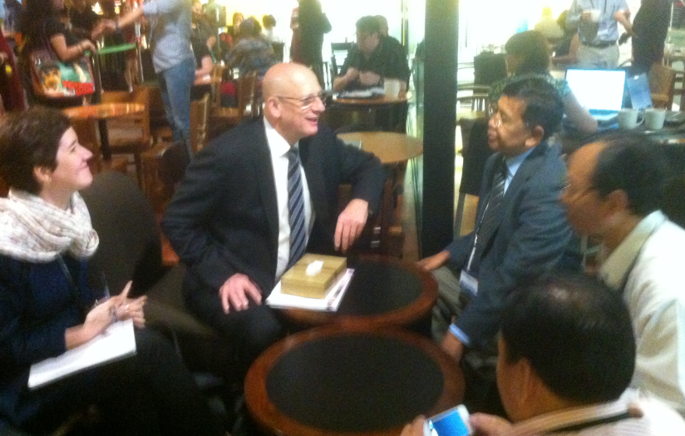
Introduction
What is the value added of the National AIDS Authority ?

Slide 4
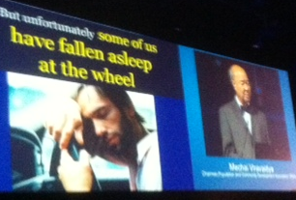
សារគន្លឹះ៩​
​ 9 ​Key messages of Leadership Forum
ពង្រឹងមគ្គុទ្ទេសភាពនិងការគ្រប់គ្រង (Leadership and Management)
វិនិយោគដោយភាពវៃឆ្លាត (SMART Investment ( low cost , high impact ))
ទិន្នន័យគឺជាអំណាច ( Data is power)
រូបអ្នកនេះហើយគឺជាអ្នកដឹកនាំ ( You are the leader)
សូមទុកសហគមន៏ជាស្នូលនៃការឆ្លើយតប ( Community as the center of the response)
ឈប់ធ្វើដូចពីមុនទៀត។​ត្រូវធ្វើតាមរបកគំហើញថ្មីInnovations ( Not business as usual ; Move with the innovation)
ជំរុញការស្វែងរកករណីថ្មីបង្កើនចំនួនអ្នកប្រើប្រាស់ឧសថប្រឆាំងមេរោគ​​​​​​​​​​​​ អេដស៏និងធ្វើអោយគាត់បន្តការព្យាបាលជាប់ជាប្រចាំ ( Accelerating case detection, maximizing ARV using , retain ARV users)
ផ្តោតលើប្រជាជនចំណុចនិងទីតាំងយុទ្ធសាស្រ្ត ( Be focus on KAPs and geographic area
លុបបំបាត់ការរើសអើងនិងមាក់ងាយ (E liminate S&D )
ប៉ុន្តែគួរអោយសោក​​ ស្តាយមានគ្នាយើងមួយចំនួនបានសំរាន្តលង់លក់នៅលើចង្កូត
But unfortunately, some of us have fallen asleep at the wheel
Khun Mechai Viravaidya
President of PDA

Slide 5
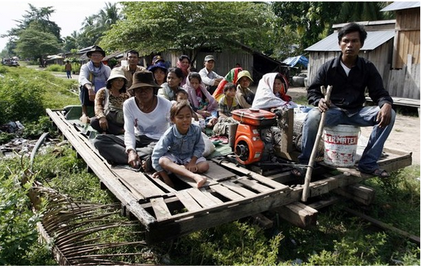
If yes how ? Is a dashboard necessary?
Are we on the right track?

Slide 6
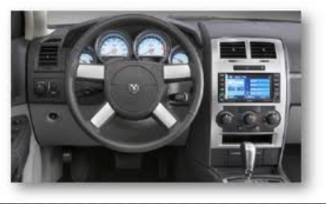
Introduction
II- Management
I- Financial
III- Program
WHO ( WHAT GROUP) IS MAKING DECISION?
Doing the right thing : Leadership
Doing thing right : Management

Slide 7
Key Phases of RBM
Strategic
Planning
Formulating SMART results
Setting targets
Selecting indicators
Monitoring performance data
Reviewing & reporting performance
Performance
Measurement
Evaluation and Lessons
Using performance information for managing
Performance
Management
UNICEF

Slide 8
Definitions
Positive and negative, primary and secondary
long-term effects produced by a
development intervention, directly or indirectly,
intended or unintended.
Impact
Outcome
The likely or achieved short-term and
medium-term effects of an intervention’s
outputs.
Output
The products and services which result from the completion of activities within a development intervention.

Slide 9
Types of Change
Impact
Changes in the lives of people
Outcome
Institutional Change: values, ethic, rules, laws – associated with to institutional performance, access..
Behavioural change: knowledge, skills, practices (individual level)
Output
Operational Change: provision of goods and services

Slide 10
Definitions
Positive and negative, primary and secondary
long-term effects produced by a
development intervention, directly or indirectly,
intended or unintended.
Impact:
HIV infections reduced
Human Change
Outcome:
An effective national response is delivered
The likely or achieved short-term and
medium-term effects of an intervention’s
outputs.
Institutional & Behavioural Change
Outputs:
The products and services which result from the completion of activities within a development intervention.
National AIDS Commission has the capacity to operate effectively and guide the national response
Products & Services
Skills & Abilities

Slide 11
Results-Chain
effectiveness
efficiency
Inputs
Activities
Outputs
Outcomes
Impact
Indicators
Assumptions/Risks

Slide 12
A Typology for RBM
Results
Like…
Focus
@
Timeframe
more
Impact
HIV incidence reduced
Human!
5-10 yrs
then
Outcome
Response brought to scale
if
Institutional/ Behavioural
5 yrs
then
Collective Accountability
Outcome
Leadership empowered
if
Institutional/ Behavioural
5 yrs
then
Output
Skills of NAC strengthened
Operational/ skills, abilities, products & services
<3 yrs
if
then
Activity
Train 250 district AIDS officers
<1 yr
less
if

Slide 13
Why RBM?
It provides a coherent framework for
strategic planning and management based on
learning and accountability.

Slide 14

បច្ចុប្បន្នភាពនៃការរាលដាលជំងឺអេដស៏នៅកម្ពុជា
ចំនួនអ្នកផ្ទុកមេរោគអេដស៏
76,000នាក់
ចំនួនស្រ្តីផ្ទុកមេរោគអេដស៏
39,000នាក់
ករណីឆ្លងមេរោគអេដស៏ថ្មី
1,400នាក់
ចំនួនស្រ្តីមានផ្ទៃពោះទទួលការព្យាបាលដើម្បីបង្ការការចំឡងមេរោគអេដស៏ទៅកូន
1,058នាក់
អ្នកជំងឺអេដស៏អាយុលើស១៥ឆ្នាំដែលត្រូវទទួលថ្នាំARV
54,000នាក់
អ្នកជំងឺអេដស៏អាយុលើស១៥ឆ្នាំដែលបានទទួលថ្នាំARV
44,318នាក់
គ្រួសារដែលរងប៉េះពាល់ដោយជំងឺអេដស៏ដែលទទួលស្បៀង
0?គ្រួសារ
ករណីស្លាប់ដោយជំងឺអេដស៏
2,700នាក់

Slide 15
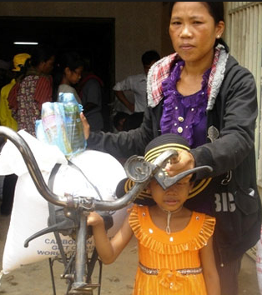
បច្ចុប្បន្នភាពនៃការរាលដាលជំងឺអេដស៏នៅកម្ពុជា
ចំនួនអ្នកផ្ទុកមេរោគអេដស៏
76,000នាក់
ចំនួនស្រ្តីផ្ទុកមេរោគអេដស៏
39,000នាក់
ករណីឆ្លងមេរោគអេដស៏ថ្មី
0នាក់
កុមារកំព្រាដោយមេរោគអេដស៏ 28,500
ចំនួនស្រ្តីមានផ្ទៃពោះទទួលការព្យាបាលដើម្បីបង្ការការចំឡងមេរោគអេដស៏ទៅកូន
1,104នាក់
អ្នកជំងឺអេដស៏អាយុលើស១៥ឆ្នាំដែលត្រូវទទួលថ្នាំARV
54,000នាក់
អ្នកជំងឺអេដស៏អាយុលើស១៥ឆ្នាំដែលបានទទួលថ្នាំARV
44,318នាក់
គ្រួសារដែលរងប៉េះពាល់ដោយជំងឺអេដស៏ដែលទទួលស្បៀង
20,000គ្រួសារ
ករណីស្លាប់ដោយជំងឺអេដស៏
0នាក់

Slide 16
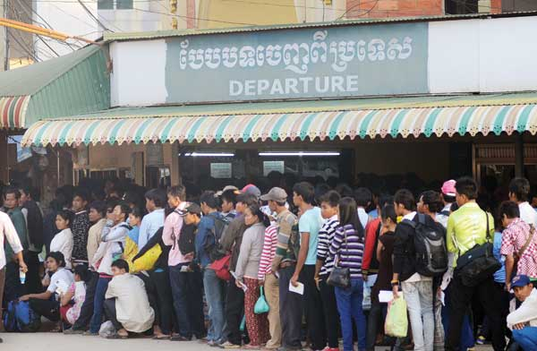
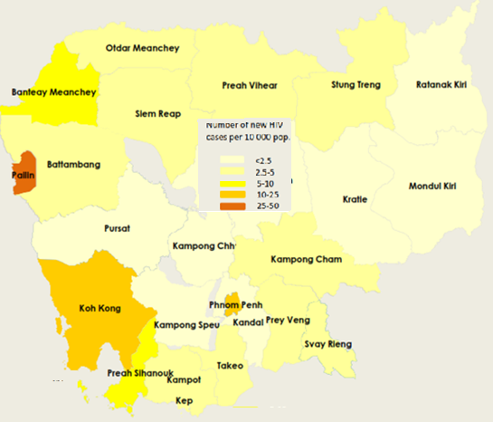
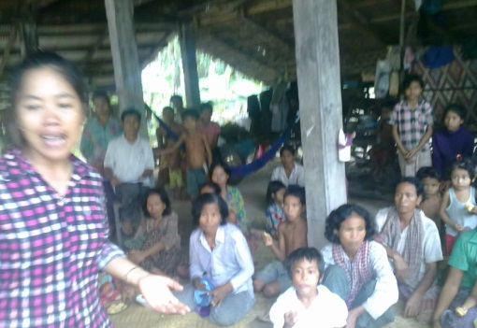


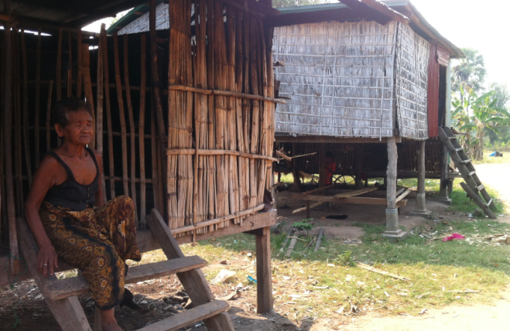
Cambodian migrants working in Thailand
Total registration of Cambodian Migrants to Thailand : 235,521+
112,275 (2011, MOPH Thailand )
HIV prevalence: 2.15% ( 2010 MOPH Thailand)

Slide 17
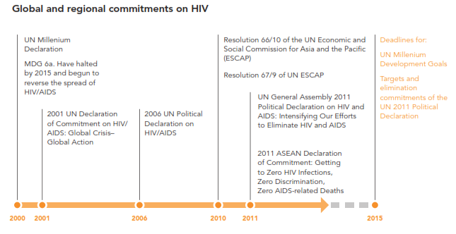
សេចក្តីប្តេជ្ញាចិត្តថ្នាក់ពិភពលោកនិងថ្នាក់តំបន់
ក្នុងការឆ្លើយតបនឹងមេរោគអេដស៏/ជំងឺអេដស៏
Global and Regional Commitments on HIV and AIDS
ថ្ងៃផុតកំណត់សំរាប់
គោលដៅសហសវត្សរបស់អង្គការសហប្រជាជាតិ
គោលដៅនិងការប្តេជ្ញាចិត្តលុបបំបាត់នៃសេចក្តីគោលនយោបាយនៃអង្គការសហប្រជាជាតិ
គោលដៅសហសវត្សរបស់អង្គការសហប្រជាជាតិ
សេចក្តីសំរេចលេខ៦៦/១០របស់ក្រុមប្រឹក្សាសេដ្ឋកិច្ច្ជនិងសង្គមនៃអង្គការសហប្រជាជាតិក្នុងតំបន់អាស៊ីនិងប៉ាស៊ីហ្វីកនៃ (ESCAP)
គោលដៅសហសវត្សទី៦បញ្ឈប់ការរាលដាលជម្ងឹអេដស៏នៅឆ្នាំ២០១៥និងផ្តើមធ្វើអោយជំងឹអេដស៏ថយចុះ
សេចក្តីសំរេចលេខ៦៧/៩របស់(UNESCAP)
២០១១សេចក្តីប្រកាសគោលនយោបាយនៃអង្គការសហប្រជាជាតិលើការងារអេដស៏:បង្កើនកម្លាំងយើងដើម្បីលុបបំបាត់មេរោគអេដស៏និងជំងឹអេដស៏
២០០១ការប្រកាសសេចក្តីសំរេចចិត្តរបស់អង្គការសហប្រជាជាតិលើការងារអេដស៏: វិបត្តិសកល-​សកម្មភាពសកល
២០០៦ការប្រកាសសេចក្តីសំរេចគោលនយោបាយរបស់អង្គការសហប្រជាជាតិ
២០១១សេចក្តីគោលនយោបាយនៃASEAN:ធ្វើអោយ០ការឆ្លងមេរោគអេដស៏ថ្មី​០ការរើសអើងនិង០ស្លាប់ដែលបណ្តាលពីជំងឹអេដស៏

Slide 18



សំរេចគោលដៅបីសូន្យ
០ឆ្លងថ្មី​ ០ស្លាប់​​​ ០រើសអើង
ដល់ឆ្នាំ២០១៥/២០២០
2011 United Nations General Assembly Political Declaration on HIV/AIDS:
Targets and elimination commitments

Slide 19
សំរេចគោលដៅបីសូន្យ
០ឆ្លងថ្មី​ ០ស្លាប់​​​ ០រើសអើង
ដល់ឆ្នាំ២០១៥/២០២០
2011 United Nations General Assembly Political Declaration on HIV/AIDS:
Targets and elimination commitments

Slide 20
Lessons learned from HIV and AIDS
Response in 2012-2013

Slide 21
Cambodian Context for HIV and AIDS Response
HIV epidemic and Funding
Results?
500 MUSD
Strategic Plan
Decades 1991-2000
Decades 2000-2010
Decades 2010-2020
STP
MTP
NSP0
NSPI
NSPII
NSPIII
NSPIV
05-06
07-08
09-10
11-12
Costing modalities
NASAI
NASAII
NASAIII
NASAIV
Resource Need Model(RNM)
Long Run Cost
(LRC)

Slide 22

Cambodian Context for HIV and AIDS Response
Partnership & country ownership
Paris Declaration on Aid effectiveness សេចក្តីប្រកាសទីក្រុងប៉ារីសស្តីពីប្រសិទ្ធភាពជំនួយ
Accra Agenda for Action
Busan HL Forum on aid effectiveness
GDJ TWG/JMI
PBA
HIV epidemic and Funding
Results?
Effectiveness?
Efficiency?
Sustainability ?
500 MUSD
Strategic Plan
Decades 1991-2000
Decades 2000-2010
Decades 2010-2020
STP
MTP
NSP0
NSPI
NSPII
NSPIII
NSPIV
05-06
07-08
09-10
11-12
Investment Framework (IF)
Costing modalities
NASAI
NASAII
NASAIII
NASAIV
Resource Need Model(RNM)
Long Run Cost
(LRC)

Slide 23
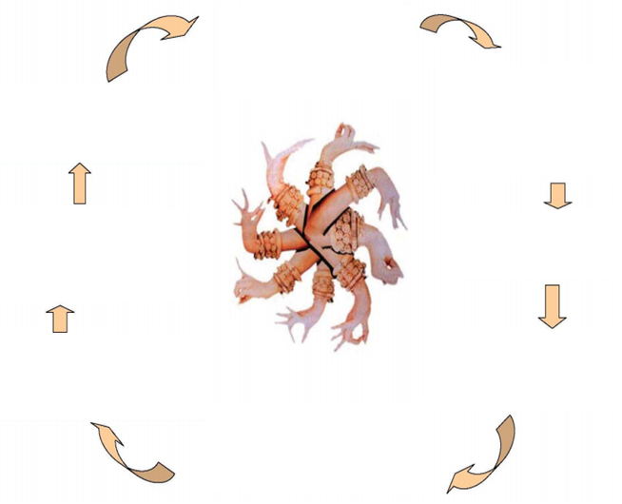
អភិក្រមគ្រប់គ្រងទូទាំងកម្មវិធី
Program Based Approach
១កម្មវត្ថុនៃះភិក្រមគ្រប់គ្រងទូទាំងកម្មវិធី
1Consensus ​​​​​​​on objectives of PBA
២ក្របខណ្ឌគោលនយោបាយទូលំទូលាយ
2 Comprehensive Policy Framework
៨ការសិក្សានិងសំរបសំរួល
8 Learning and adaptation
៧ការលើកកំពស់សម្ថភាពបចេ្ចកទេស
7 Capacity Development component
៣គោលដៅរួមគ្នា
3 Common Goals
៦ការឯកភាពលើរចនាសម្ព័ននិងការបែងចែកភារកិច្ជ 6 Agreed institutional arragements and responsibilities
៤ក្របខណ្ឌរៀបចំការប្រើប្រាសថវិកាទូលំទូលាយ
4 Comprehensive Resource Framework
៥ភាពជាដៃគូនិងរចនាសម្ព័ន្ធសំរាប់ធ្វើការសន្ទនា
5 Partnership and dialogue structures
Source : www.cdc-crdb.gov.kh

Slide 24
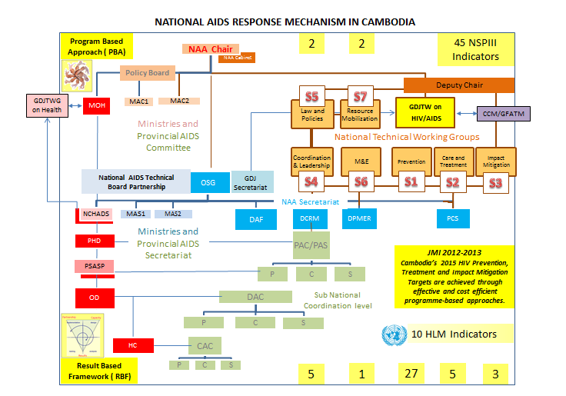
-
JMI- Joint Monitoring Indicators 2012-2013​) of
GDJ TWG on HIV and AIDS
Cambodia’s 2015 HIV Prevention, Treatment and Impact Mitigation Targets are achieved through cost effective and efficient programme-based approaches

Slide 25
Key Events in 2013
United Nations
  National Stakeholder Consultation for the Mid-term Review of the Progress towards the Targets of the 2011 UN Political Declaration on HIV/AIDS​​ June 2013 ( HLM) 10 Indicators for Three Zero
  GARPR : UNGASS
NSP III ( Review ) ….NSPIV
GDJ TWG on HIV and AIDS
  ( 2012 -2013 JMI )
  Partnership Development Strategies (GDJ TWG Retreat in Siem Reap) 12-13 Nov 2013
  National HIV Health Sector Program Review in Cambodia 29 April – 10 May 2013
HIV-Sensitive Social Protection for Impact Mitigation in Asia and the Pacific
ICAAP11 ( 16-22 November 2013)
GFATM
  SSF Reprogramming August 2013
  Gender Review
  OIG Report / Recovery
  NFM Application for 2016-2018
  New Term of CCM
  GFATM SSF Phase 2 ( signing in 2Jan 2014)
  Incentives Scheme and Proposed Incentives ( December 2013 )
NAA
  Investment framework for effective response to HIV and AIDS
  New Structure of the National AIDS Authority ( 27September and 18 November 2013)
  Policy Board Meeting ( 28 November 2013)
  7 Points policy directives ( 17 December 2013)
How these activities are initiated ? How those activities are coordinated?

Slide 26
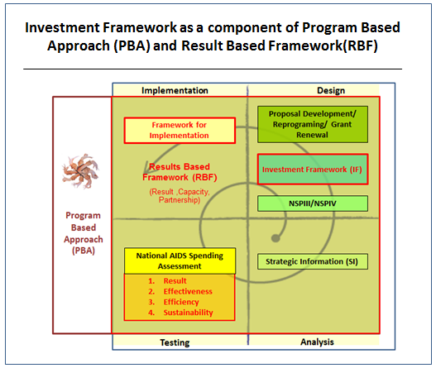

Slide 27
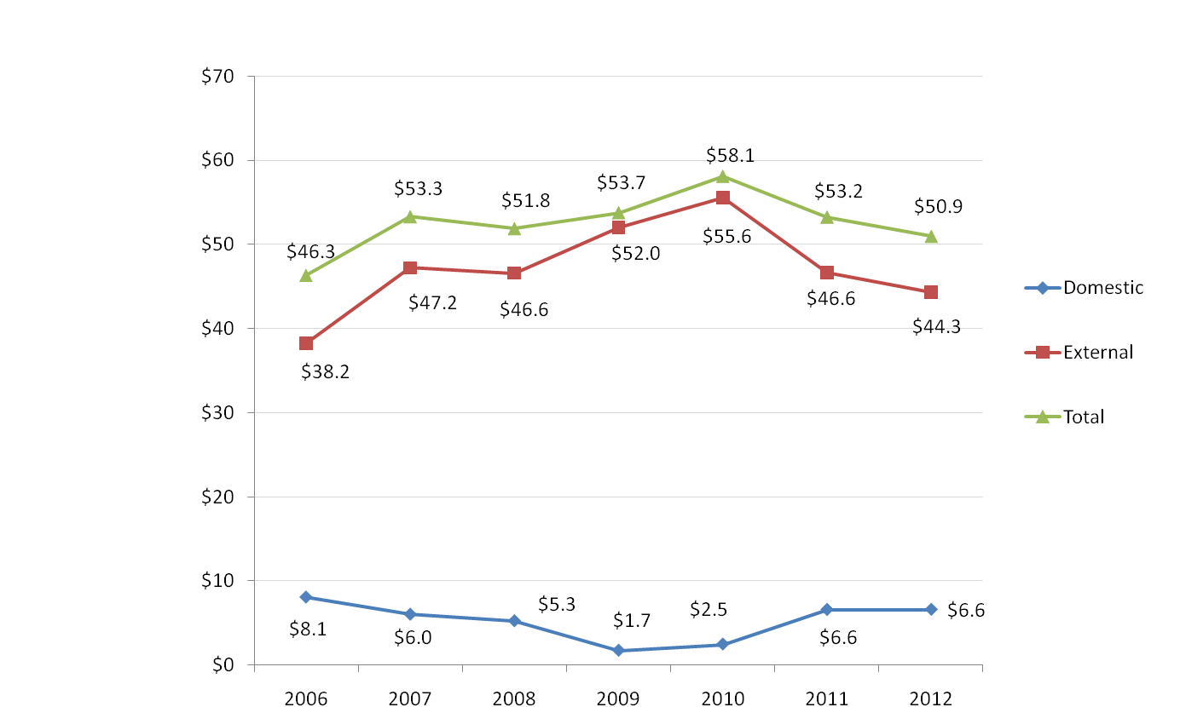
Domestic vs. External Sources (millions of USD)
Spending from external sources was reduced by 20% from 2010 to 2012
NASA III didn’t include 2.5m$ p.a. of salaries paid by RGC

Slide 28
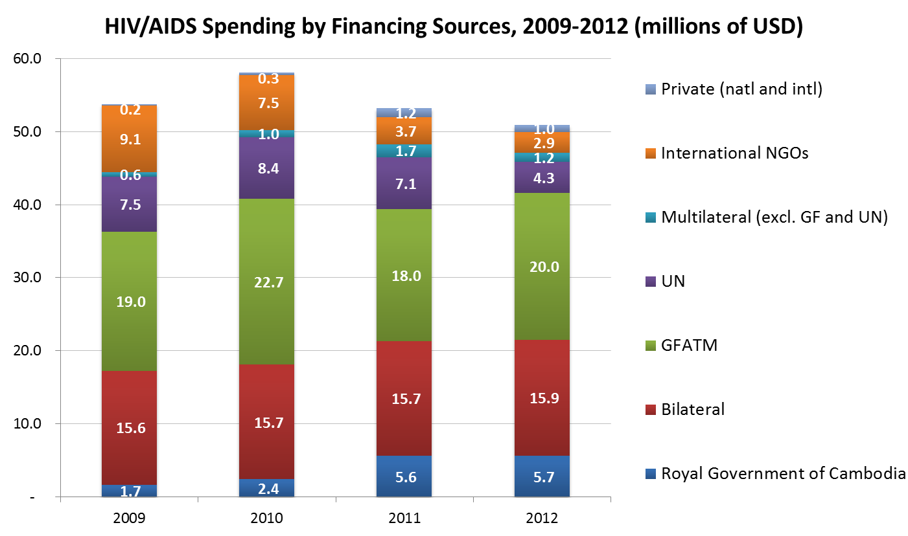
HIV/AIDS Spending by Financing Sources, (millions of USD)

Slide 29
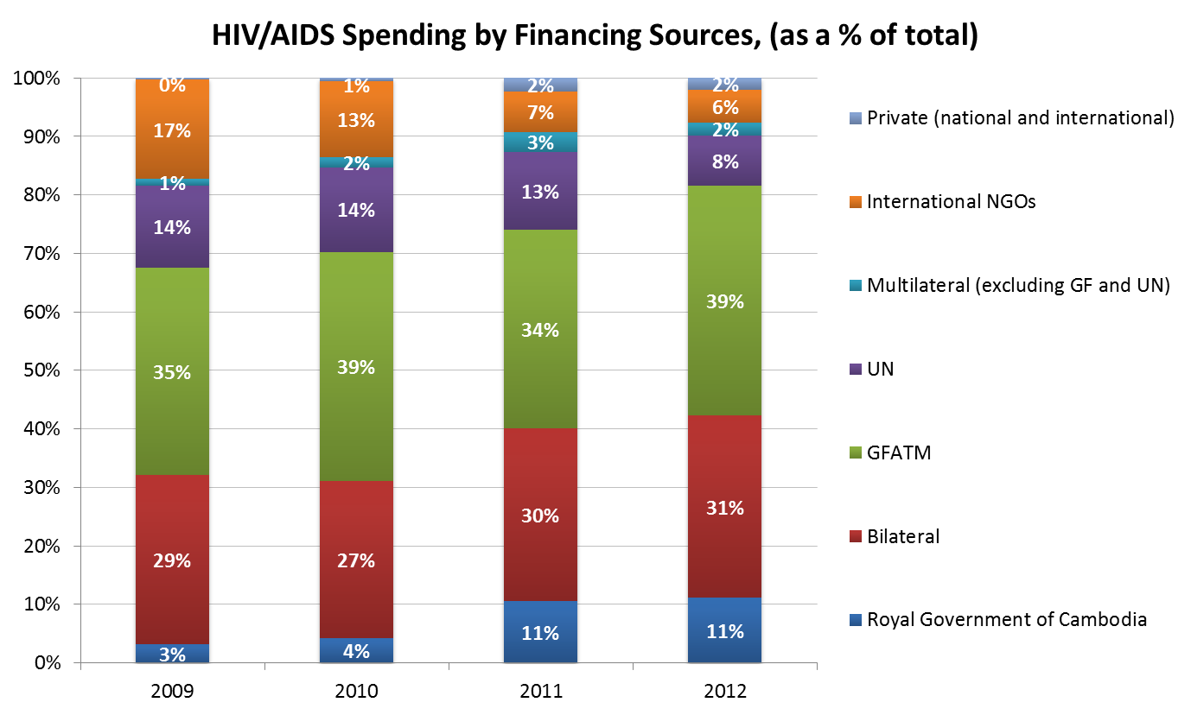
HIV/AIDS Spending by Financing Sources, (% of total)

Slide 30
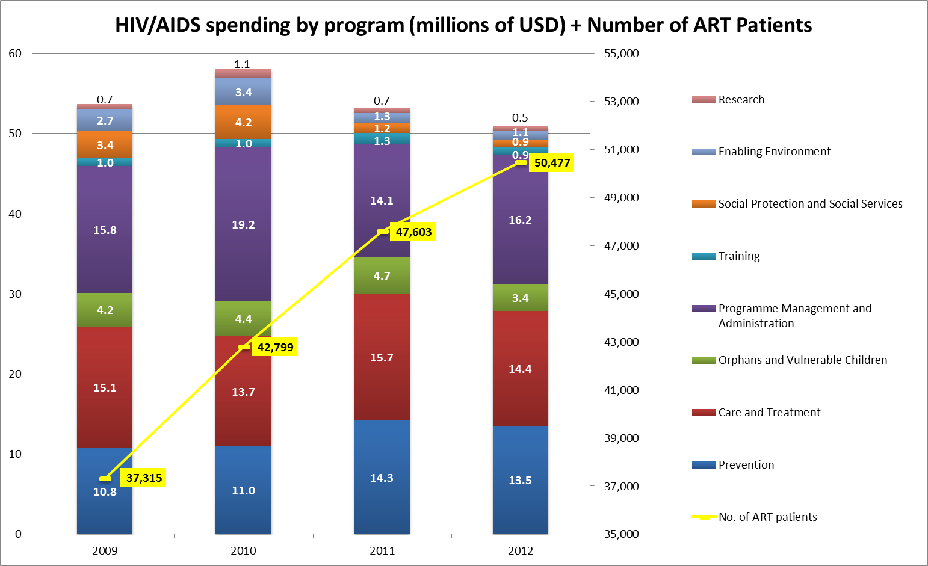
HIV/AIDS Spending by ASC (millions of USD) and
Number of ART Patients

Slide 31
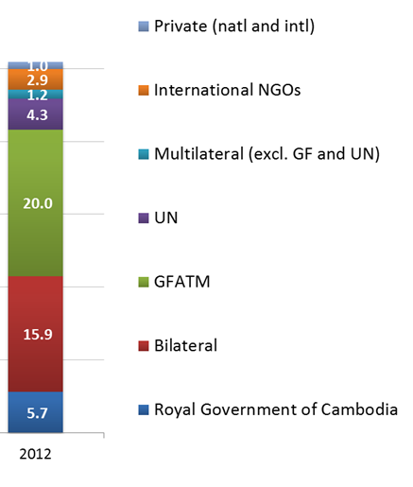
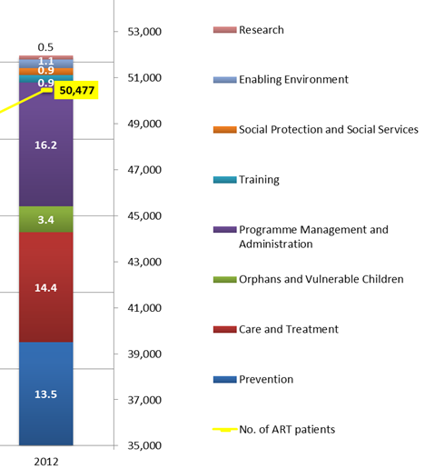
Budget allocation
WHO ( WHAT GROUP) IS MAKING DECISION?

Slide 32
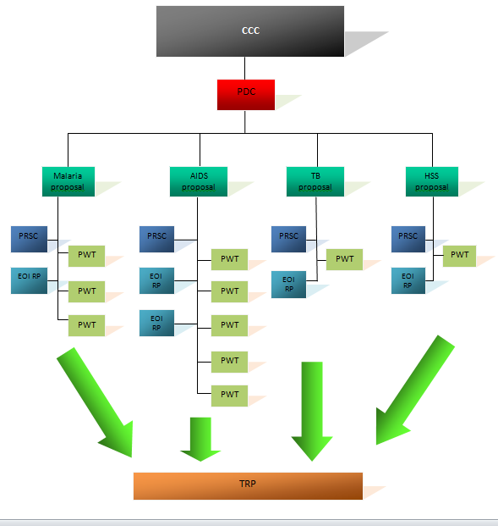
Proposal Development Committee
( Round Based Application)

Slide 33
Budget allocation

Slide 34
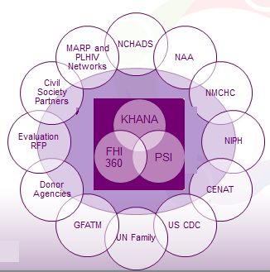
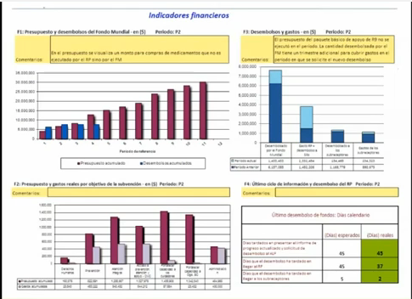
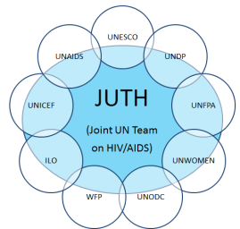
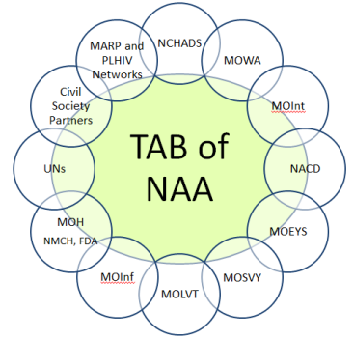
Monitoring HIV and AIDS Response
CCC
LFA
CCC Oversight
PR ( SR, SSR)
URC
Monitoring Flagship Program
GDJTWG on HIV and AIDS

Slide 35

GF Board
យន្តការគ្រប់គ្រងមូលនិធិសកល
GFATM Management
GF Secretariat
OIG
Audit
Investigation
Portfolio Manager
Guiding documents
Governance Manual
PD Manual
Conflict of interest
Policy
MOH
CCC
CCC Ex Com
CCC OC
PDC
WG
AIDS
WG TB
WG Ma
WG HSS
GDJTWG on HIV and AIDS
GDJTWG on Health
LFA
PR
PR
PR
PR
Guiding documents
Program Grant Agreement
HR Manual
Finance Manual
Procurement Guidelines
SR Management Guidelines
M&E Guidelines
PR Coordinating Group
SR
SR
SR
SR
SSR
SSR
SSR
SSR

Slide 36


ការប្រៀបធៀបមួយ
A dashboard is needed
Financial
Management
Program
បុគ្គលិករដ្ឋះ​២០០០នាក់
បុគ្គលិកសង្គមស៊ីវិលះ៤០០០នាក់
ប្រជាជនគោលដៅះ១០០០០០នាក់

Slide 37
II- Management
I- Financial
III- Program
WHO ( WHAT GROUP) IS MAKING DECISION?

Slide 38

Grant Dashboard​ (GFATM)
II- Management
Where are the drugs?
Are sub-recipients receiving resources and technical assistance as schedule?
I- Financial
Where is the money?
III- Program
Are activities implemented as planned ?
Do the results match the performance goals ?
Recommendations
Actions

Slide 39
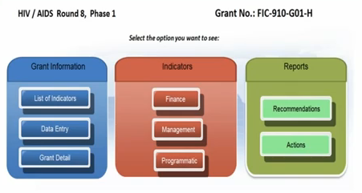

Slide 40
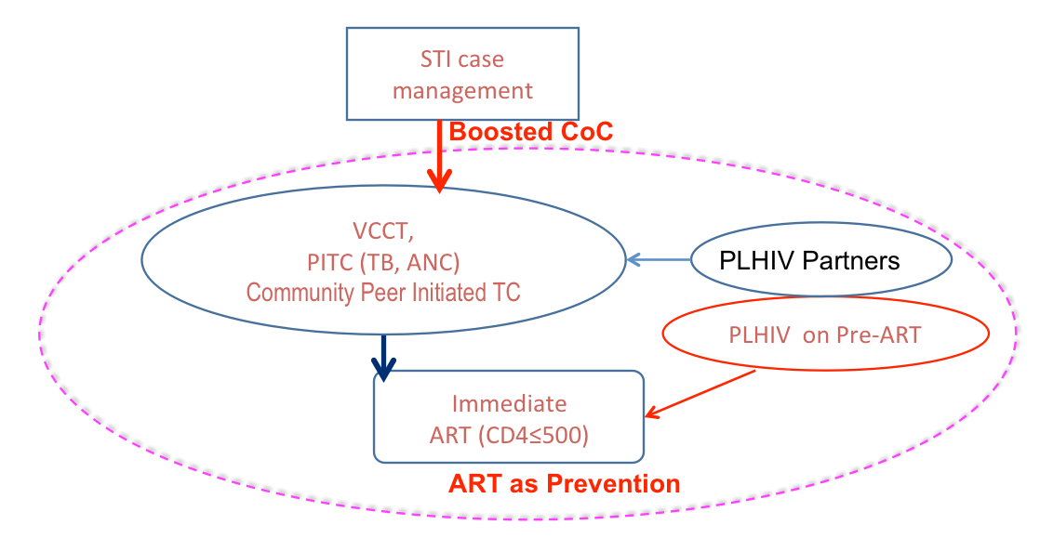
Boosted COPCT Response
Injecting plus sex work
Injecting DUs
Sharper epidemiological targeting: reaching those at highest risk
All
Male/TG sex workers
MSM ‘pleasure circuit’
Non injecting DU EW
‘Massage’
KTV
Some
Beer promoters
...
Few
Casino workers

Slide 41
Current Trends in Health Financing
Health Financing Indicators | In 2008 | in 2012
Total Health expenditure (THE) ( US$ M) | 564 | 763
General government Health expenditure ( GGHE) ( US$ M) | 105 | 187
External expenditure on health ( US$ M) | 111 | 117
Total health expenditure per capita | 41 | 52
Total health expenditure as % of GDP | 5.5 | 5.4
General government Health expenditure ( GGHE) as % of THE | 19 | 24.5
External expenditure on health as % of THE | 19.7 | 15.3
Out of pocket expenditure on health as of % of THE | 61.5 | 60.2
Total HIV and AIDS expenditure ( US$M) | 51.8 | 50.9
Total HIV and AIDS expenditure as % of THE | 9.2 | 6.7
Government HIV and AIDS expenditure as % of GGHE | 5 | 3
Source : Health Financing report 2012, MoH , NASA IV, 2013

Slide 42
Health Sector Review
Urgent need to prepare a resource needs and mobilisation plan for sustained funding for essential HIV and AIDS services until 2020
  Sustain donor funding at adequate levels , increase domestic funding through diverse mechanisms as part of gradual integration of the HIV Program in broader Health system
  In the shift towards more domestic funding, continuum of key prevention,care and treatment program needs to be mainted
  Increase value for money to allocate resources to the most effective programs and improve service delivery and management efficiencies
Agreement on mechanism to increase domestic funding as a contribution of supply ( e.g. ARVs, Condoms) and demand side ( e.g. inclusions of ART, STI services in socal health protection schemes) financing under the new health financing policy

Slide 43
Next steps in the coming two years
Expand and use evidence at central and provincial levels for priority settings and to inform the multi-year plan, systematically evaltuate program
  Ongoing/ complete NASA IV, budgeting for GF HIV/SSF grant phase 2 costing ,Cambodia 3.0
  To be developed effectiveness and efficiency assessment , unit costs and resources need estimates
Develop a multi-Year resources needs and mobliisation plan to advocate and work with development partners, MOH, MOEF, other non health Ministreis, and other programs
Engage with MOH to contribute to the development and implmentation of Cambodia Healht strategic Plan from 2016 onwards and Cambodia Health Financing Policy

Slide 44
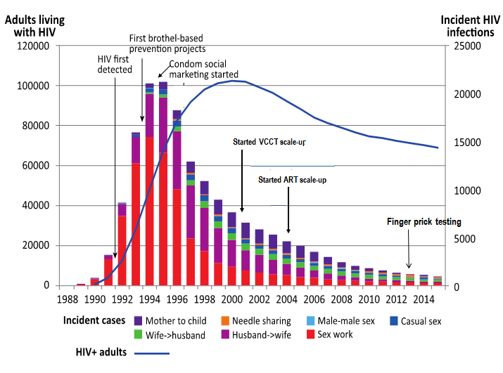
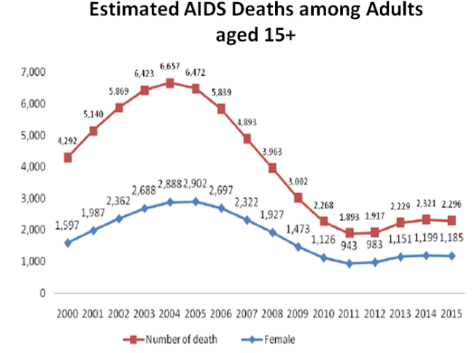
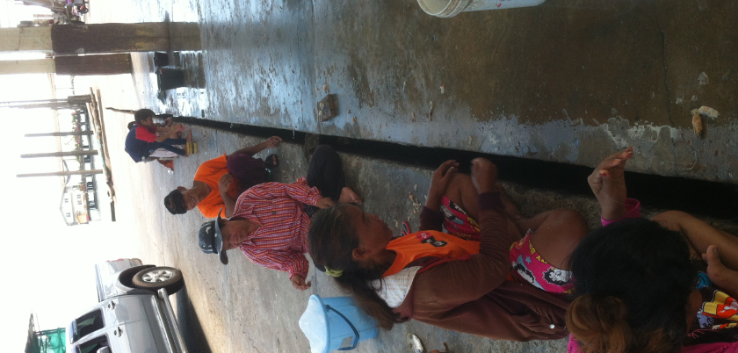
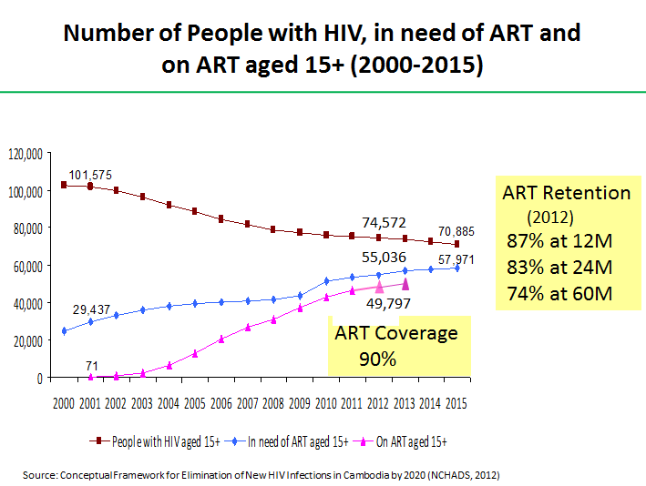
Are we on a secure road “Getting to Zero ?”

Slide 45
AIDS Spending Category
Asia and Pacific and Cambodia

Slide 46
Managing HIV and AIDS Response in 2014-2015

Slide 47
Is there any innovative structure to replace it ?
Cambodia’s 2015 HIV Prevention, Treatment and Impact Mitigation Targets are achieved through cost effective and efficient programme-based approaches

Slide 48
CAM-H-NCHADS Phase 2
 | 2014 | 2015 |  | TOTAL | %
Summary budget by cost category | YEAR 1 | YEAR 2
Human Resources | 5,534,823 | 6,312,397 |  | 11,847,220 | 21%
Technical and Management Assistance | 788,125 | 725,718 |  | 1,513,843 | 3%
Training | 1,696,646 | 1,784,304 |  | 3,480,950 | 6%
Health Products and Health Equipment | 3,294,693 | 3,253,082 |  | 6,547,775 | 11%
Pharmaceutical Products (Medicines) | 6,508,240 | 6,511,840 |  | 13,020,081 | 23%
Procurement and Supply Management Costs (PSM) | 1,262,288 | 1,370,572 |  | 2,632,860 | 5%
Infrastructure and Other Equipment | 458,145 | 293,733 |  | 751,878 | 1%
Communication Materials | 254,666 | 152,626 |  | 407,293 | 1%
Monitoring and Evaluation (M&E) | 2,346,086 | 2,774,916 |  | 5,121,002 | 9%
Living Support to Clients/Target Population | 3,606,408 | 4,170,604 |  | 7,777,011 | 13%
Planning and Administration | 1,201,376 | 1,081,246 |  | 2,282,622 | 4%
Overheads | 1,028,943 | 1,233,256 |  | 2,262,199 | 4%
Other | - | - |  | - | 0%
TOTAL | 27,980,441 | 23,578,249 |  | 57,644,735

Slide 49
CAM- HIV- SSF Phase II

Slide 50
Estimated Resources for 2014

Slide 51
Cambodia : Keys actions on GA Resolution 65/277
Target 1 | Key actions | Responsible | Timeline
 | Raise the understanding and share experience on the Boosted CoPCT SOP for MARPs at the national and sub-national levels. | Coordination: NCHADS | Q4 2013
 |  | Contributors: key NGOs, UNICEF, WHO, UNAIDS, US-CDC, MARPs.
 | Conduct mapping exercise to identify and locate MARPs at higher risk and services delivery points for a better planning and delivery of services. | Coordination: NCHADS | Q3 2013
 |  | Contributors: key NGOs, UNICEF, WHO, UNAIDS, CDC, MARPs.
 | Revise PCPI training and monitoring tools to ensure effective implementation and monitoring of the initiative. | Coordination: NAA/MoI | Q3 2013
 |  | Contributors: KHANA, FHI360, HACC, UNAIDS.
 | Review the Boosted CoPCT SOP and adapt its services to the immediate and evolving needs of MARPs, especially those who face multiple risks. | Coordination: NCHADS | Q3 2014
 |  | Contributors: key NGOs, UNICEF, WHO, UNAIDS, US-CDC, MARPs.
Target 2 | Finalize and approve the NSP policy and SOP reflecting clear institutional leadership in overseeing and managing the NSP and related programmes. | Coordination: National Mental Health Programme (Ministry of Health)/NACD | Ongoing process
 |  | Contributors: NACD, WHO, UNAIDS, HAARP, KHANA, Mith Samlanh, Korsang, FHI360.
 | Accelerate transition of the NSP licensing authority from NACD to the Ministry of Health. | Coordination: National Mental Health Programme (Ministry of Health) | Q3 2013
 |  | Contributors: NACD, WHO, UNAIDS, HAARP, KHANA, Mith Samlanh, Korsang, FHI360.
 | Implement CPITC initiatives among PWUD and PWID. | Coordination: NCHADS | Q3 2013
 |  | Contributors: WHO, UNAIDS, KHANA, Mith Samlanh, Korsang, FHI360.
 | Advocate for better cross border coordination between Thailand and Cambodia on the issue of CoPTC for Migrant Workers | Coordination: NCHADS /NAA | Q1 2014
 |  | Contributors : ASEAN ATFOA, JUNIMA/ UNDP
Target 3 | Operationalize the recommendations of the recent Health Sector HIV Programme Review and conduct necessary and consistent follow-up. | Coordination: NMCHC | Starting Q3 2013
 |  | Contributors: NCHADS, key implementing NGOs, WHO/JUTH, CDC, CHAI
 | Conduct implementation research for new services and approaches to test for efficiency and effectiveness, prioritizing the most important target groups. | Coordination: NMCHC | Starting Q3 2013
 |  | Contributors: NCHADS, key implementing NGOs, UNICEF
 | Integrate PMTCT into national health system and funding mechanisms to ensure the sustainability of PMTCT (see Target 10). | Coordination: MOH | On-going process
 |  | Contributors: NCHADS, NMCHC, key implementing NGOs, UNICEF/JUTH
Target 4 | Operationalize the recommendations of the recent Health Sector HIV Programme Review and conduct necessary and consistent follow-up. | Coordination: NMCHC | Starting Q3 2013
 |  | Contributors: NCHADS, key implementing NGOs, WHO/JUTH, CDC, CHAI
 | Conduct implementation research for new services and approaches to test for efficiency and effectiveness, prioritizing the most important target groups. | Coordination: NMCHC | Starting Q3 2013
 |  | Contributors: NCHADS, key implementing NGOs, UNICEF
 | Integrate PMTCT into national health system and funding mechanisms to ensure the sustainability of PMTCT (see Target 10). | Coordination: MOH | On-going process
 |  | Contributors: NCHADS, NMCHC, key implementing NGOs, UNICEF/JUTH
Target 5 | Operationalize the recommendations of the recent Health Sector HIV Programme Review and conduct necessary and consistent follow-up. | Coordination: NCHADS | Starting Q3 2013
 |  | Contributors: CENAT, NMCHC, key implementing NGOs, WHO/JUTH, US-CDC, CHAI.
 | Conduct implementation research for new services and approaches to test for efficiency and effectiveness, prioritizing the most important target groups. | Coordination: NCHADS | Starting Q3 2013
 |  | Contributors: NCHADS, key implementing NGOs, UNICEF
 | Integrate care and treatment into national health system and funding mechanisms to ensure the sustainability of these services (see Target 10). | Coordination: MOH | On-going process
 |  | Contributors: NCHADS, key implementing NGOs, WHO/JUTH, CHAI
Target 6 | Identification and costing of key program interventions of NSP III/IV by using the Investment Framework | Coordination: NAA | Q3-4 2013
 |  | Contributors: key ministries, implementing NGOs, UNs and Development Partners
 | Develop a five year resource mobilisation plan to guide funding applications with the RGC as well as external donors. | Coordination: NAA | Q1 2014
 |  | Contributors: key ministries, implementing NGOs, UNs and Development Partners
 | Assessment of current HIV funding governance mechanisms and recommendations for gradual harmonisation/integration within national systems | Coordination: NAA, as part of the NSP III mid-term review (MRT) | Q3-4 2013
 |  | Contributors: NCHADS, relevant departments in MoH, MoP, MEF and other ministries, UNAIDS, WHO, US-CDC, GiZ
 | Use the governance and accountability structure to mobilize resource from funding agencies including GFATM | Coordinator: NAA | Starting Q1 2014
 |  | Contributors: NCHADS (Costed health sector response to HIV/AIDS, key implementing NGOs, UN and other development partners
Target 7 | Comprehensive HIV-related gender (including GBV) review of national response to HIV | Coordination: NAA in collaboration with MOWA, UN agencies and CSOs | Q3-4 2013
 | Develop clear strategy and indicators on GBV and HIV | Coordination: NAA in collaboration with MoWA, UN agencies and CSOs | Q2 2014
 | Development of an evidence informed Action Plan on GBV and HIV (consistent with NSP III mid-term review (MRT)recommendations and NAPVAW) | Lead: MoWA in collaboration with NAA, NCHADS, with inputs from development partners and CSOs | Q1 2014
Target 8 | National review of Law and Policy barrier for the AIDS response (as per Cambodia’s commitment to the ESCAP) | Coordination: NAA | Q3-4 2013
 |  | Contribution: key ministries, civil society, UNAIDS/UNDP
 | Legal literacy among Law enforcement bodies and the PLHIV and MARPs communities | Coordination for Law enforcement bodies: NAA in collaboration with MOI and relevant development partners and communities | Q4 2013
 |  | Coordination for communities: CPN+ in collaboration with networks of MARPs with support from NGOs working on Legal and human rights, government and relevant development partners and UN agencies
 | Implementation of action on PCPI with a clear monitoring system established | Coordination: NAA and MOI | Q3-4 2013
 |  | Contribution: UNAIDS/ relevant development partners and NGOs
Target 10 | Conduct MTR of NSP III (including the issues on governance and accountability framework for country response to HIV and AIDS). | Coordination: NAA | Q2-Q3 2013
 |  | Contributors: UNs/Development partners, CRDB/CDC, MARPs Network, CSOs and key ministries
 | Review and update when needed recommendations of the ‘Review of SP for Incorporating HIV Sensitivity’ report and identify key actions to implement them | Coordination: NAA | Q2 2013
 |  | Contributors: CARD, key ministries, implementing NGOs, UNDP/JUTH
 | Address remaining information gaps on HIV specific SP services e.g. service coverage and gaps, unit and total costs | Coordination: NAA, possibly as part of the NSP III mid-term review | Q3-4 2014
 |  | Contributors: CARD, key non-health ministries, implementing NGOs, UNAIDS/JUTH
 | Ensure planning and resource mobilization for continued essential SP services for HIV affected households while pursuing opportunities for gradual integration of management and service delivery mechanisms | Coordination: NAA | Q3-4 2013 for HIV/SSF grant
 |  | Contributors: CARD, key non-health ministries, implementing NGOs, UNAIDS/JUTH | Annual RGC budgeting periods
 |  |  | 2015 for new GF grant

Slide 52
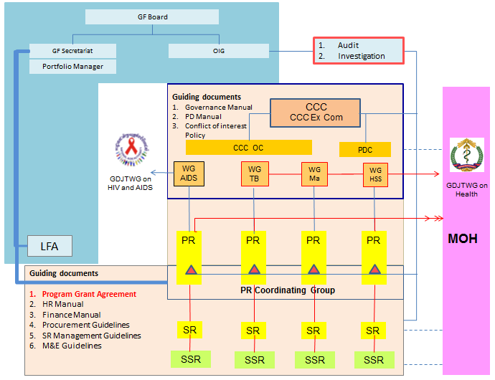
What is the line of accountability?
GDJTWG on HIV and AIDS
GDJTWG on Health
GFATM
Technical Advisory Board
FLAGSHIP
United Nations

Slide 53
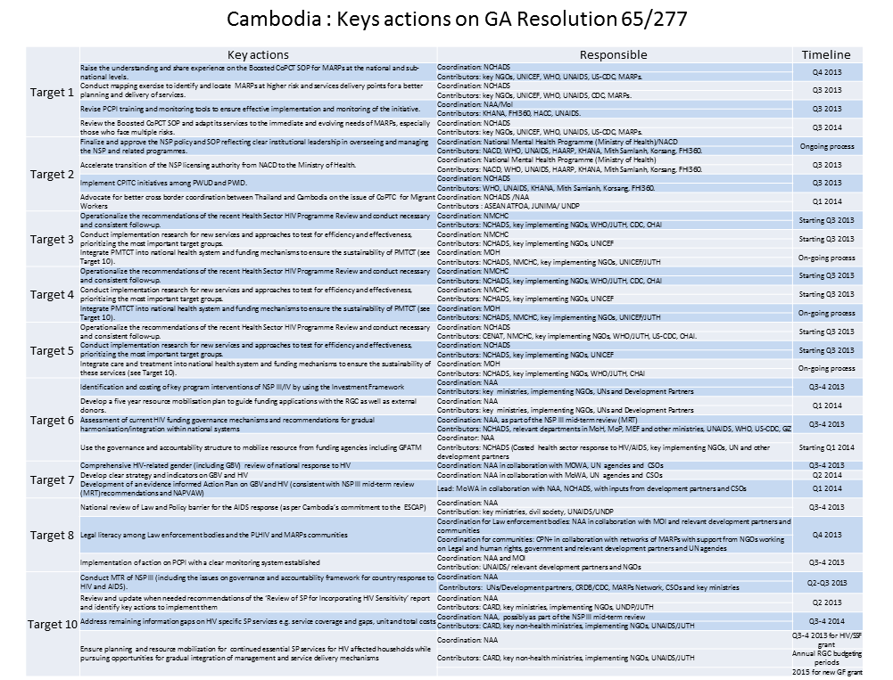
GDJTWG on HIV and AIDS
Continuum of Prevention , Care treatment and support
Impact Mitigation
Enabling Environment and HR
Leadership and Development synergies

Slide 54
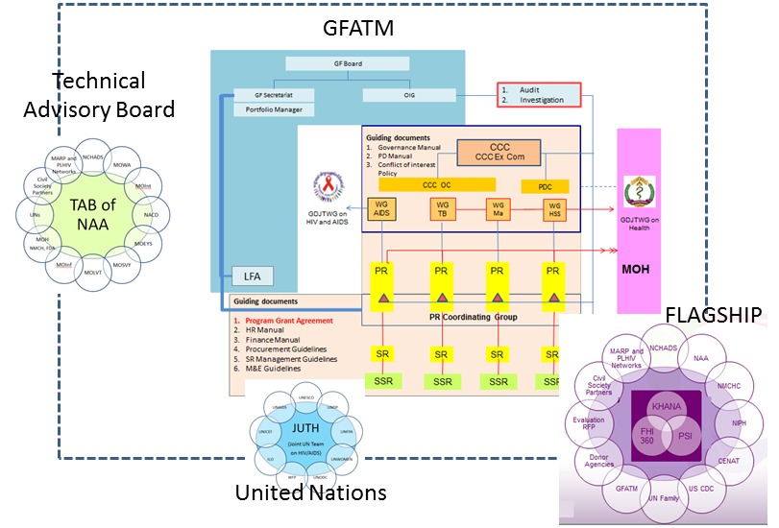
GDJTWG on HIV and AIDS
Continuum of Prevention , Care treatment and support
Impact Mitigation
Enabling Environment and HR
Leadership and Development synergies

Slide 55
Conclusions and
Recommendations

Slide 56

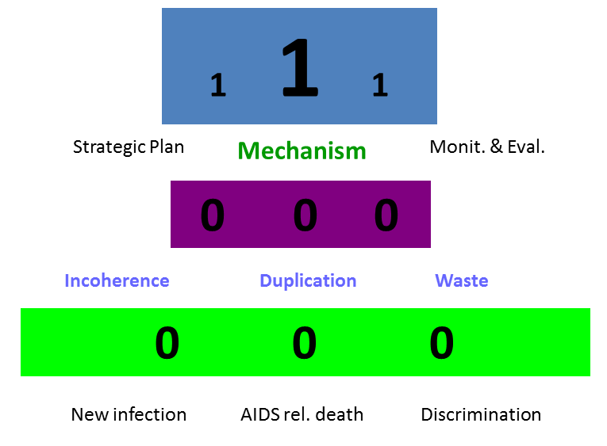
Strengthening coordinating structure
សំរេចគោលដៅបីសូន្យ
០ឆ្លងថ្មី​ ០ស្លាប់​​​ ០រើសអើង
GDJTWG on HIV and AIDS
Continuum of Prevention , Care treatment and support
Impact Mitigation
Enabling Environment and HR
Leadership and Development synergies
I- Financial
II- Management
III- Program

Slide 57
GF Board
យន្តការគ្រប់គ្រងមូលនិធិសកល
GFATM Management
GF Secretariat
OIG
Audit
Investigation
Portfolio Manager
Guiding documents
Governance Manual
PD Manual
Conflict of interest
Policy
MOH
CCC
CCC Ex Com
CCC OC
PDC
WG
AIDS
WG TB
WG Ma
WG HSS
GDJTWG on HIV and AIDS
GDJTWG on Health
LFA
PR
PR
PR
PR
Guiding documents
Program Grant Agreement
HR Manual
Finance Manual
Procurement Guidelines
SR Management Guidelines
M&E Guidelines
PR Coordinating Group
SR
SR
SR
SR
SSR
SSR
SSR
SSR

Slide 58
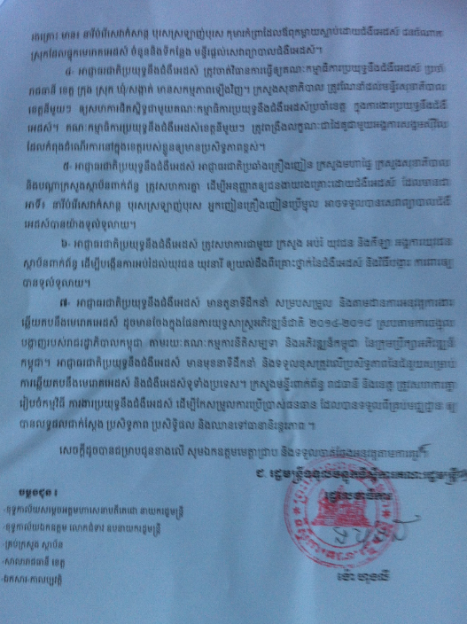
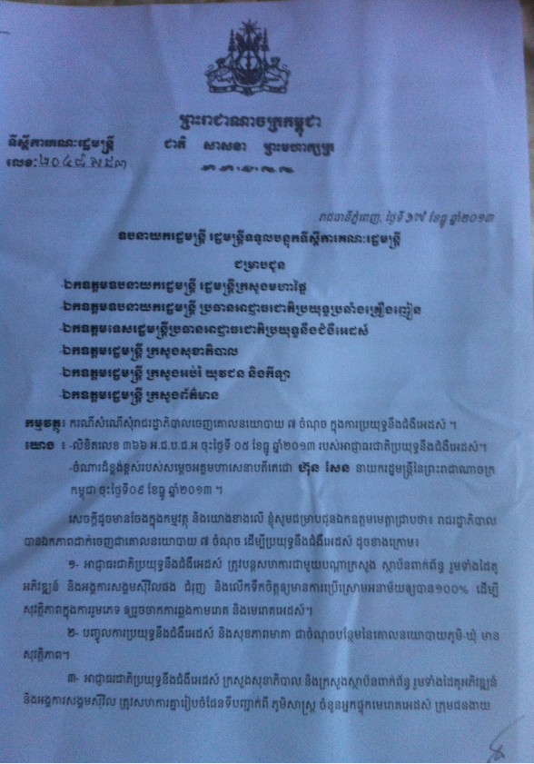

Slide 59
7 Point Policy Directives
1. The National AIDS Authority should continue coordination with relevant ministries and institutions as well as with development partners and civil society organizations to promote and encourage the 100% use of condom for the sake of safe sex, a mean of preventing the transmission of sexual disease and HIV virus.
2. Incorporate the fight against AIDS and mother health-care as additional points in the Village-Commune Safety policy of the Ministry of Interior.
3. The National AIDS Authority, the Ministry of Health, along with relevant ministries and institutions, the development partners, and the civil society organizations should coordinate in mapping out localities identifying the number of PLHIV and MARPs --including entertainment workers, men having sex with men, orphans and vulnerable children, and PLHIV who migrate-as well as the number and locations of establishments providing continuum of prevention and HIV and AIDS treatment and related services.

Slide 60
7 Point Policy Directives
4. The National AIDS Authority should take measures to reactivate AIDS-fighting Committees at capital, provincial, districts, communes, and sangkats. The Ministry of Health should advice Provincial Health Department to closely coordinate with Provincial AIDS Committee/ Secretariat for HIV and AIDS response. Every Provincial AIDS Committee/ Secretariat should strengthen partnership with civil society organizations operating in respective province to enhance effectiveness of the response.
5. The National AIDS Authority, the National Authority for Combating Drugs, the Ministry of Interior, the Ministry of Health, and relevant ministries and institutions should coordinate for creating an enabling environment for MARPs, including entertainment service girls, men having sex with men, and injecting drug users, to have access to comprehensive HIV and AIDS treatment services.
6. The National AIDS Authority should coordinate with the Ministry of Education, Youths, and Sports, youth organizations, and relevant institutions to broaden education for male and female young people to equip them with an accurate understanding of the danger of HIV and AIDS and to inform them on comprehensive preventive options.

Slide 61
7 Point Policy Directives
7. The National AIDS Authority has leading roles in coordinating and monitoring the implementation of the work on HIV/AIDS as mentioned in the National Strategic Development Plan 2014-2018 in conformity with the guidance provided by the Royal Government of Cambodia through the Cambodia Rehabilitation and Development Committee of the Cambodia Development Council. The National AIDS Authority has leading roles on aid effectiveness and bears the responsibility for a nationwide HIV and AIDS response. Relevant ministries, Phnom Penh and Provincial AIDS Committees should coordinate to develop respective HIV and AIDS action plan for optimizing the use of funding received from all sources in order to achieve tangible, effective, and efficient results and move forward in ensuring sustainability of the response.

Slide 62
Mobilizing resources for 2016-2018
Use existing guiding principles , SOP and guidelines/directives , commitments ( PBA, RBF, ..)
NSPIV Development
Application of NFM

Slide 63
NSPIII Review
NSPIV
Submission for
GFATM by using NFM
2016-2018

Slide 64
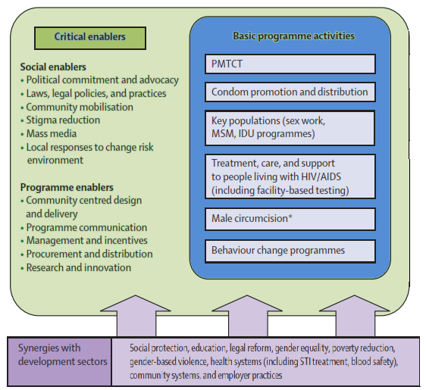
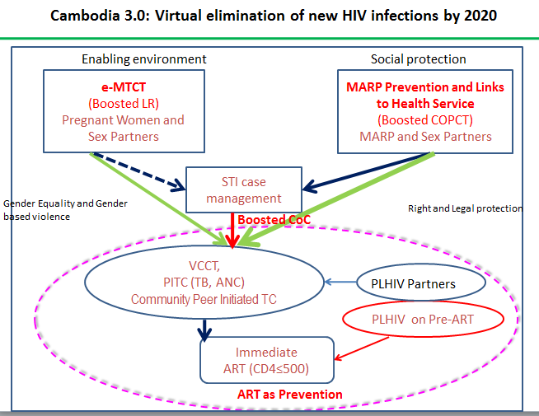
Investment Framework in Cambodia

Slide 65



គ្រប់គ្រងដើម្បីលទ្ធផល
(Managing for results)
ប្រាសាទភិមានអាកាស
Phimeanakas
4
1
ភាពធ្វើជាម្ចាស់
Ownership ( Partner countries )
ដៃគូរៀបចំ របៀបវារ:ការងារ(Partners set agenda)
5
2
តំរឹមរបៀបវារ:​ ការងាររួមគ្នាជាមួយ ដៃគូ(Aligning with partners’ agenda)
ភាពតំរឹម
Alignment ( Donors-Partners)
ប្រើប្រាស់ប្រព័ន្ធរបស់ដៃគូ( Using partners’ system
គណនេយ្យភាពទ្វេទិស​​​
Mutual Accountability
3
សុខុដុមនីយកម្ម
Harmonization ​​​​​​​​​​​​​​​ ( Donors-Donors)
សំរួលបទដ្ឋានអោយងាយ ( Simplifying procedures)
ចែកចាយព័ត៌មាន ( Sharing information
រៀបចំអោយមាន ការឯកភាពរួមគ្នា ( Establishing common arrangements)

Slide 66
Robust country dialogue is the foundation​(NFM)
People living with HIV, TB patients, people who have had malaria
HIV, TB and malaria programs incl. health staff and Health system planners
Migrants, refugees, internally displaced people, ethnic minorities, forest fringe workers
Country Dialogue with diverse group of stakeholders to identify priorities to put in the Concept Note
Women's organizations
People who inject drugs
Key Affected Populations: national networks
Domestic human rights experts
Men who have sex with men (MSM) and transgender people
Youth
Sex workers

Slide 67
In country dialogue, stakeholders convene to jointly strengthen the country's disease response
Donors, private sector, academia
Government
(What Group?)
Civil society, key affected populations
Technical partners
Global Fund
CCM
Lead process, timing, and engagement for Global Fund requests
Support data analysis and evaluation of programs
Develop national strategy
Identify linkages with other programs and research
Identify barriers to access and quality that reduce impact
Provide indicative funding amount
Map the funding landscape to ensure alignment and complementarity
Discuss disease and health sector landscape: develop a common understanding of epidemiology, areas for coordination and weaknesses in health or community systems
Contribute to Concept Note development, gap analysis, and full expression of demand
(CCM leads and submits)

Slide 68
GDJTWG on HIV and AIDS function regularly
Continuum of Prevention , Care treatment and support
Impact Mitigation
Enabling Environment and HR
Leadership and Development synergies
Sub-TWG on HIV and AIDS
function regularly

Slide 69
Key Events in 2014-2015
United Nations
  National Stakeholder Consultation for the Mid-term Review of the Progress towards the Targets of the 2011 UN Political Declaration on HIV/AIDS​​ June 2013 ( HLM) 10 Indicators for Three Zero
  GARPR : UNGASS
NSP III ( Review ) ….NSPIV
GDJ TWG on HIV and AIDS
  ( 2012 -2013 JMI )
  Partnership Development Strategies (GDJ TWG Retreat in Siem Reap) 12-13 Nov 2013
  National HIV Health Sector Program Review in Cambodia 29 April – 10 May 2013
HIV-Sensitive Social Protection for Impact Mitigation in Asia and the Pacific
GFATM
  SSF Reprogramming August 2013
  Gender Review
  OIG Report / Recovery
  NFM Application for 2016-2018
  New Term of CCM
  GFATM SSF Phase 2 ( signing in 2Jan 2014)
  Incentives Scheme and Proposed Incentives ( December 2013 )
NAA
  Investment framework for effective response to HIV and AIDS
  New Structure of the National AIDS Authority ( 27September and 18 November 2013)
  Policy Board Meeting ( 28 November 2013)
  7 Points policy directives ( 17 December 2013)
NCHADS
Continuum of Prevention , Care treatment and support
Impact Mitigation
Enabling Environment and HR
Leadership and Development synergies

